Slide 1

Data Analytics - Final Project
Project 1. Steps

Slide 2
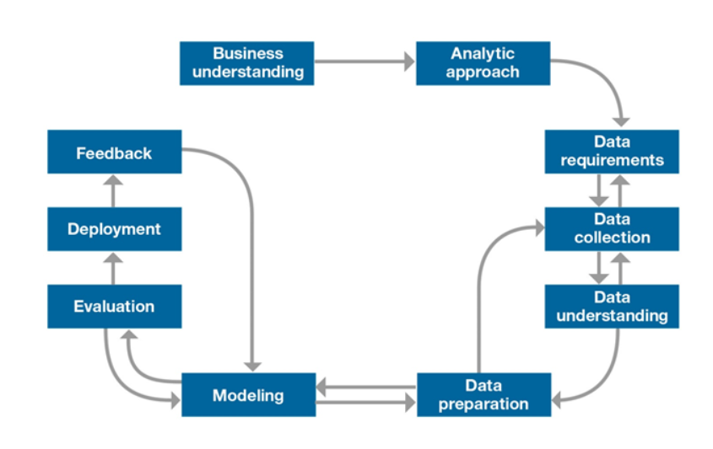
Plan a Data Analytics Project
Story Telling
(notnecessary)

Slide 3

Plan a Data Analytics Project
< 1. Brainstorm Data Project Ideas>
To begin your data analytics project, you will need an idea to work on. To get started, brainstorm possible ideas that might interest you. During this process, go as wide and as crazy as you can, don’t censor yourself. Once you have a few ideas, you can narrow down to the most feasible/interesting idea.

Slide 4
Plan a Data Analytics Project
< 1. Brainstorm Data Project Ideas>
What excites you enough that you would enjoy working on the following weeks? What kind of data exists in that space?
Do you have any pain points associated with the products and services you use each day and could they be improved?
Where do you want to work? What kind of app would showcase your skills to your potential employer?
Are there products that you could design for social good?
What kind of tools would you like to learn/practice? What kind of projects could you work on that enable you to use these tools?

Slide 5
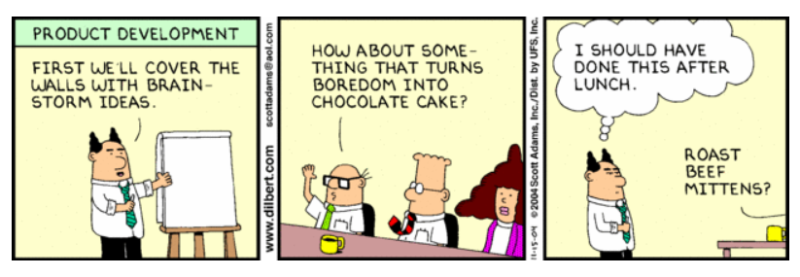
Plan a Data Analytics Project
< 2. Business understanding: from problem to approach>
What’s the problem you’re trying to solve?
What are the business needs you are trying to address?
What are the objectives of the project?

Slide 6

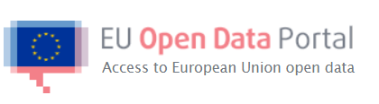

Plan a Data Analytics Project
< 2. Business understanding: datasets >
Kaggle:
https://www.kaggle.com/datasets
EU Open Data portal
https://data.europa.eu/euodp/en/data/
Google Datasets search
https://datasetsearch.research.google.com/

Slide 7


Plan a Data Analytics Project
< 2. Business understanding: define your KPI’s >
Time prediction
From sales and stocks to
preventive maintenance
KPI
Prediction accuracy
Key Performance Indicator (KPI)
Most common KPI’s in tech industry

Slide 8

Plan a Data Analytics Project
< 3. Data understanding >
We need to collect the data and try to understand it, to see if it fits with the business problem that we have defined.

Slide 9
Plan a Data Analytics Project
< 3. Data understanding >
What kind of data is available to you?
Is it stored in a database?
How large is your data?
Can it be stored and processed on your hard drive or will you need cloud services?
Are the any confidentiality issues or NDAs involved if you are working in partnership with a company or organization?
Can you find a new data set online that you could merge and increase your insights.

Slide 10
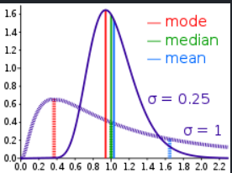
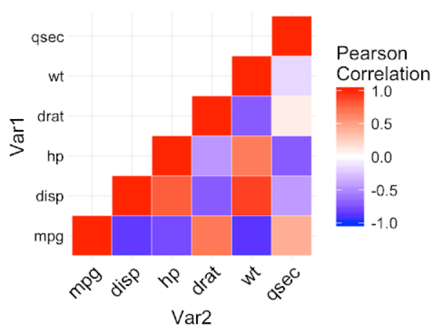
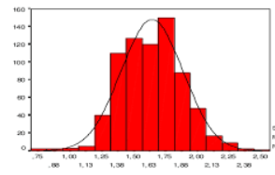
Plan a Data Analytics Project
< 3. Data understanding_ TOOLS >
< Univariate statistics >
* Univariate analysis of each variable, with some emphasis on the target variable
Mean, median, max, min...
< Bivariate statistics >
* Bivariate analysis of the variables, to see variable are highly correlated which means they would be essentially redundant
< Histograms >
Used to understand the distribution of the variables.

Slide 11
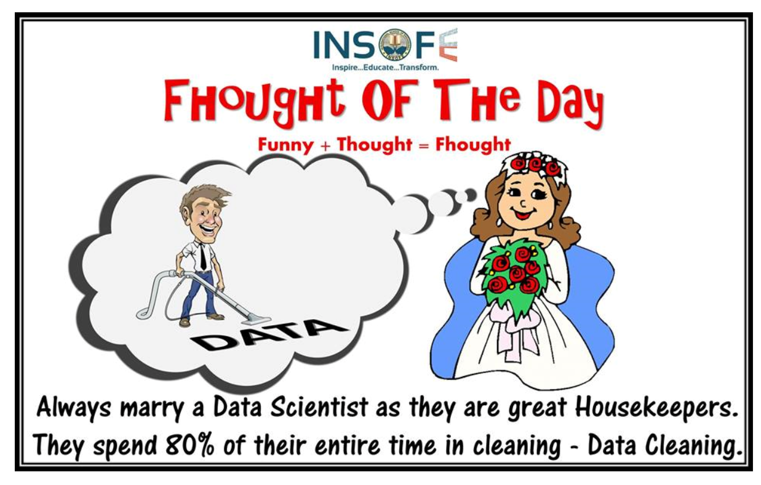
Plan a Data Analytics Project
< 4. Data Preparation >
This is an essential step which involves the preparation of the data : DATA CLEANING

Slide 12
Plan a Data Analytics Project
< 4. Data Preparation >
This stage involves doing a little Exploratory Data Analysis and thinking about how your data will fit into the model that you have.
Is the data in data types that are compatible with the model?
Are there missing values or outliers?
Are these naturally occurring discrepancies or errors that should be corrected before fitting the data into a model?
Do you need to create dummy variables for categorical variables?
Will you need all the variables in the data set are some dependent on each other?

Slide 13


Plan a Data Analytics Project
< 4. Data Preparation_ TOOLS >
< Missing Values>
* Identify the missing values
* Assess whether they are important or not
* Drop them or replace them by the mean, median...
< Drop Duplicates >
* Identify whether you have duplicated in your dataset and drop them

Slide 14
Plan a Data Analytics Project
< 5. Story telling >
A commonly used framework to structure presentations is the Situation-Problem- Solution-Next Steps (SPSN) framework
<Situation> To start, describe the current state to your audience. What is the status quo you’re trying to change?
<Problem> Next, picture the problem. What’s the issue with the situation? Wherein lies the pain you’re trying to solve?
<Solution> Present the solution. How do you solve the problem? How do you cure the pain?
<Next Steps> You convinced the audience. What are the next steps you need to take? Which actions need to be taken?

Slide 15





Plan a Data Analytics Project
< 5. Story telling_TOOLS >
< Python modules >
* Matplotlib
* Seaborn
* Plotly
*...
<Data visualization tools >
* Tableau, QlikView, PowerBI...

Slide 16
Plan a Data Analytics Project
Some references
Data science methodology:
https://medium.com/@yassine.hammar1/data-science-methodology-or-the-master-plan-to-succeed-your-ds-project-d21397cf52b2
Data science projects:
https://www.edureka.co/blog/data-science-projects/
Nice example of a DS project:
https://github.com/JostineHo/mememoji
Story telling: https://towardsdatascience.com/storytelling-for-data-scientists-317c2723aa31

Slide 17

allwomen.tech
<
Thank you! Gracias! Merci!
hello@allwomen.tech
allwomen.tech
>

